Slide 1



Technical Writer Test - Customer Release Notes
January, 2021

Slide 2
Project
Based on the following updates made in the latest version of our product, please construct a Customer Release Note.
Feel free to organize the information and the document structure in the manner you feel best conveys the message.

Slide 3
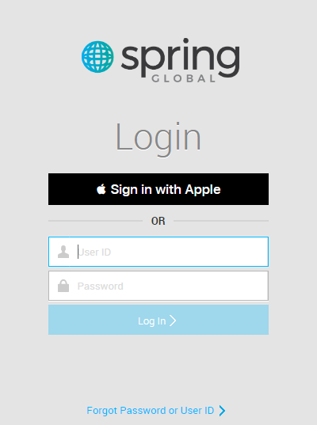
Sign in with Apple ID
Now it’s possible to sign in in mSeries (Spring Global App) portal using Apple ID
Apple ID Authentication feature is intended to login users using Apple as authentication provider.
This feature adds "Sign in with Apple" button and 'OR' separator on HQPortal's login page as shown in the image below.

Slide 4
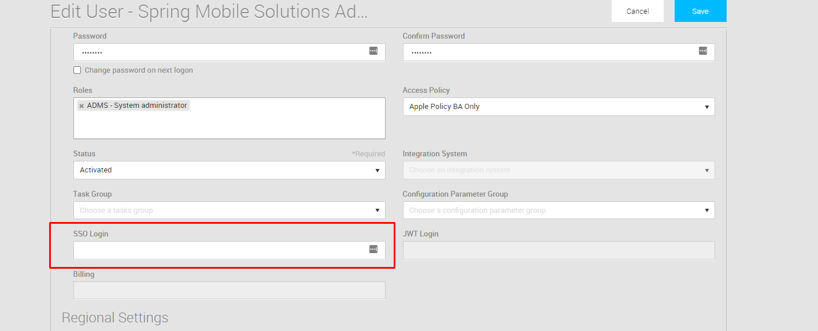
Sign in with Apple ID
How to configure
Apple ID account should be linked to HQPortal user.
With an admin profile go to Administration -> User -> [Select desired user] -> User Profile tab -> SSO Login then, define the Apple ID account than will be linked to this user.

Slide 5
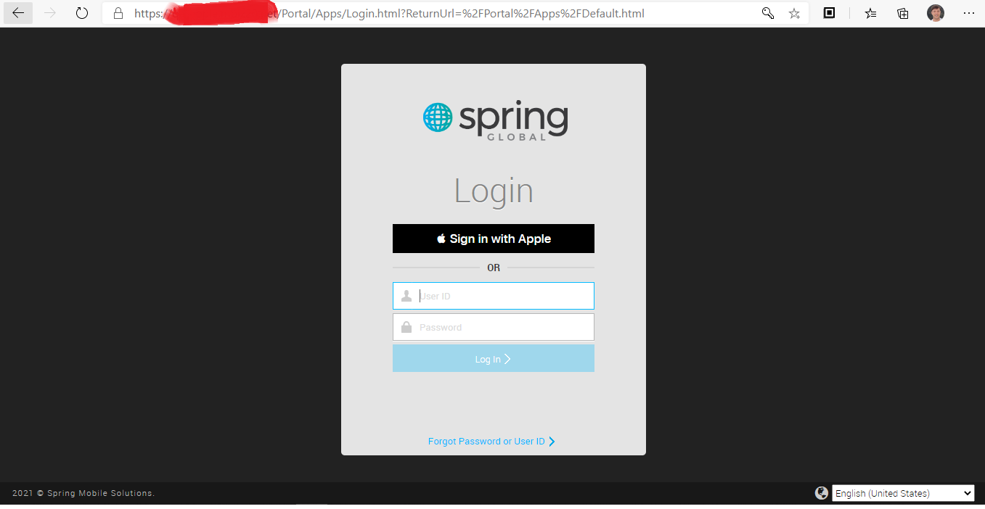
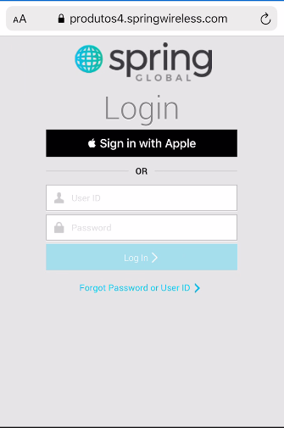
Sign in with Apple ID
How to use
Open your environment HQ Portal URL in a browser (from a Desktop or a mobile device) and try to log in with the mSeries user that was previously associated to the AppleID.
Desktop view
Mobile View

Slide 6
Order Edit Improved Rules
To improve the usability and prevent unwanted and accidental Order Edits additional Rules are being added.
When editing an Order that has previously been Finalised you now need to select an Edit button. This helps us to better manage when users just view an Order and don’t edit it. The new edit button is present in both "My Order" and "Order Detail" screens and will be visible whenever the user has the appropriate permissions to edit a finalised order. Clicking the button will reopen the order as exemplified bellow:

Slide 7
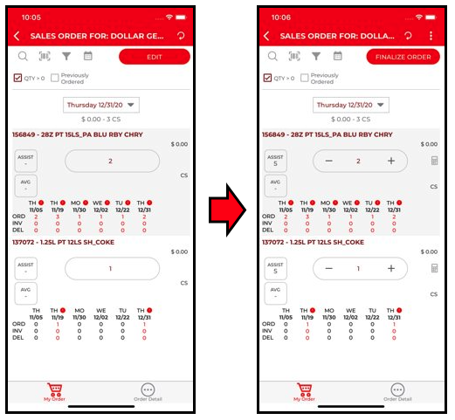
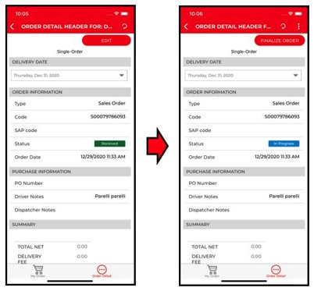
Order Edit Improved Rules
Order Edit in My Order Screen
Order Edit in Order Detail Screen

Slide 8
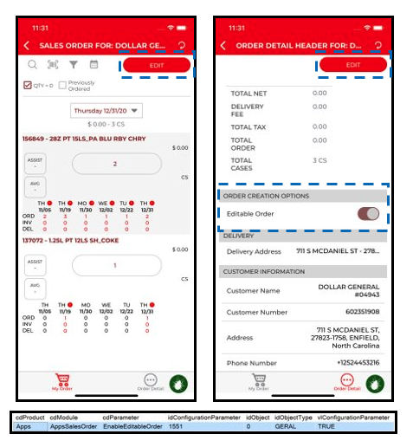
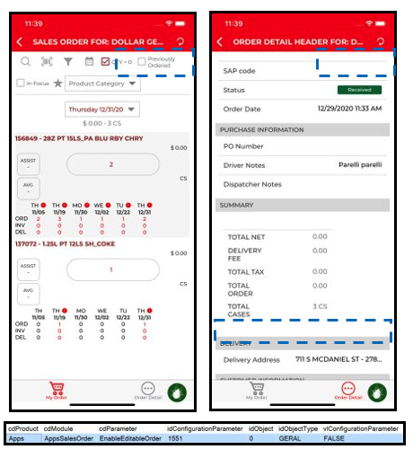
Order Edit Improved Rules
Order Edit can now be managed by a new Configuration Parameter "EnableEditableOrder" so it can be enabled/disabled by Bottler or Region within a Bottler. If disabled, the Edit button above is not available. Additionally, the Flag – Order Editable – is also hidden.

Slide 9
Bug Fixes
Return Reason Issue
Return reason selection for first order displayed when tapping on Material description in Multi-Order scenario
Solution: In multiorder removed behavior because not make sense for single order when tap in product, price, or spinner, the selection return reason will be shown, but for multi-order, only in the price or spinner for the self-order, see images touchable areas bellow:

Slide 10
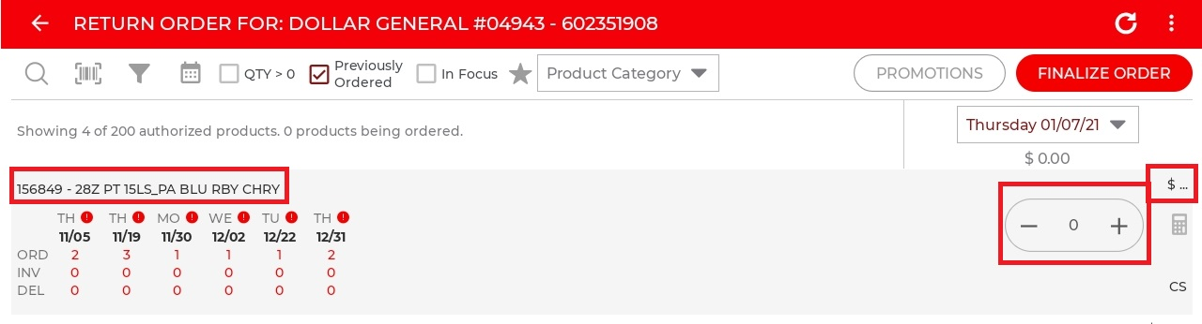
Bug Fixes
Return Reason Issue
Single Order

Slide 11
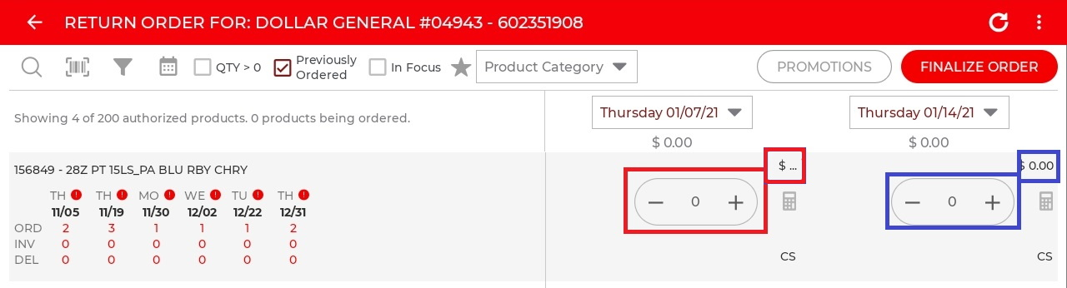
Bug Fixes
Return Reason Issue
Multi Order

Slide 12
Customer Release Notes

